Slide 1
JOURNAL ENTRIES

Slide 2
Classification of accounts :
Personal account – Names individuals, firms, representatives personal account
Ex: Rama a/c, Suresh s/c, SBI a/c, Outstanding salaries a/c
Real account – Deals with purchase and sale of assets
Ex: Building, Furniture
Nominal account – Deals with all expenses and losses and incomes and gains
Ex: Salaries paid, Rent received

Slide 3
Rules
Personal account
Debit the receiver
Credit the giver
Real account
Debit what comes in
Credit what goes out
Nominal account
Debit all expenses and losses
Credit all incomes and gains

Slide 4
STEPS FOR JOURNALISING
1. First ascertain the two accounts involved in the transactions.
2. then see the nature of accounts
3. then apply corresponding rules

Slide 5
Journalise the following transaction
1 Jan 2019 car purchased for cash for Rs.2000
First identify the exchanging items
Car Cash
Asset Asset
Real account Real account
Apply the real a/c formula

Slide 6
Real a/c rule
Debit what comes in -- Car
Credit what goes out -- cash
1.1.20 Car a/c Dr. 2000
To cash a/c 2000
(being car purchased)

Slide 7
Building Purchased for cash Rs.15000
Exchange items
Buildings Cash
Asset asset
Real a/c real a/c
Buildings a/c Dr. 15000
To cash a/c 15000
(being buildings purchased)

Slide 8
Cycle sold for cash Rs.1000
Cycle– asset—real a/c
Cash – asset – real a/c
Entry—
Cash a/c Dr. 1000
To cycle a/c 1000

Slide 9
Journalise the following transactions
1. Land purchased for cash Rs.2000
2. Gold sold for cash Rs.1000
3. Furniture sold for cash Rs.1500
4. Goods purchased for cash Rs.3000
5. Sold goods for cash Rs.2500
6. Mixi purchased for Rs.200
7. Cycle sold for Rs. 150
8. Purchased goods from Mahesh Rs.240

Slide 10
Goods purchased from Gopi Rs.150
Cash deposited in to Bank Rs.250
Cash withdraw from Bank Rs.300

Slide 11
Land a/c Dr. 2000
To Cash 2000
(being land purchased)
Cash a/c Dr. 1000
To Gold a/c 1000
(being gold sold)
cash a/c Dr. 1500
To Furniture a/c 1500
(being furniture purchased)
Purchases a/c Dr. 3000
To Cash a/c 3000
(being goods purchased)
cash a/c Dr. 2500
To sales a/c 2500
(being goods sold)

Slide 12
Mixi a/c Dr. 200
To cash a/c 200
(being mixi purchased)
Cash a/c Dr. 150
To cycle a/c 150
(being cycle sold)
Purchases a/c Dr. 240
To Mahesh a/c 240
Purchases a/c Dr. 150
To Gopi a/c 150
Bank a/c Dr. 250
To Cash a/c 250
Cash a/c Dr. 300
To Bank a/c 300

Slide 13
Received cash from Deepak – Cash a/c Dr. 154
To Deepak a/c 154
Cash paid to Ajay – Ajay a/c Dr. 200
To Cash a/c 200

Slide 14
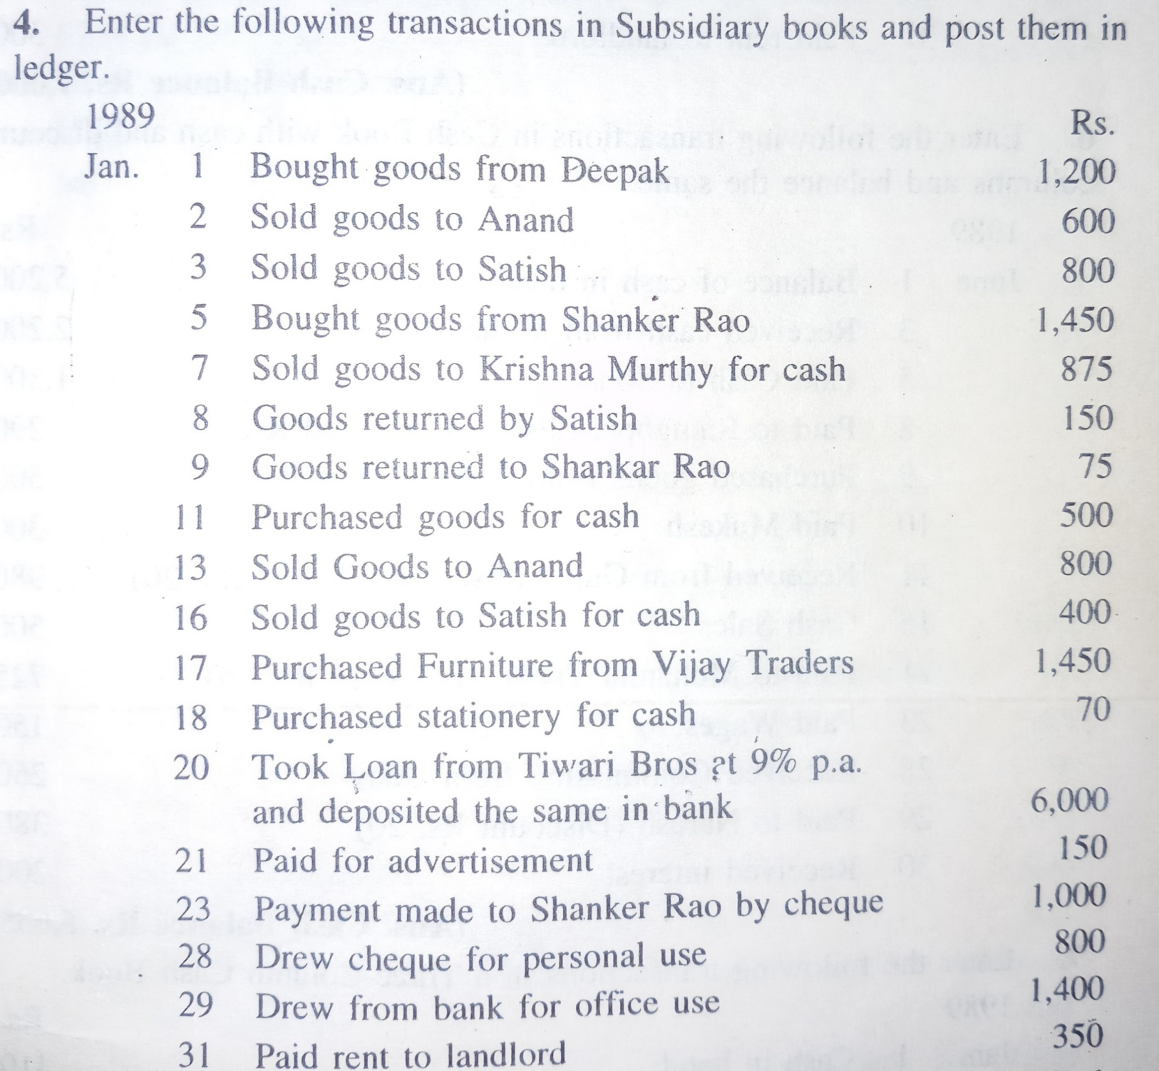

Slide 15
LEDGER
After journalising the transactions, the entries in the Journal are transferred to appropriate accounts in the ledger to know the exact position of each account on any particular date.
Ledger is a book in which various personal, real, nominal accounts are opened and posing are made.

Slide 16
All business transactions are first recorded in the journal and then recorded in ledger.
The process of transferring the transactions from journal to the ledger is called Posting.
PROFORMA OF LEDGER
Dr. Cr.
_______________________________________
Date Particular Amount Date Particular Amount
_______________________________________

Slide 17
Journalise the following transactions and post them in ledger
Ram commenced the business Rs.50000 -- Cash a/c Dr
To ram capital a/c
2. Deposited in bank Rs.40000 -- Bank a/c Dr.
To Cash a/c
3. Purchased machinery payment made by cheque Rs.20000 -- Machinery a/c Dr.
To Bank a/c
4received commission sarath Rs.4000 cash a/c Dr.
To commission a/c
5. Paid salary to Arun Rs.3000 Salary a/c Dr.
To cash a/c

Slide 18
Date | Particular | Amount | Date | Particular | Amt
 | To Ram capital To Commission | 50000 4000 54000 |  | By Bank By Salary a/c By balance c/d | 40000 3000 11000 54000
Cash a/c
Ram capital a/c
Date | Particular | Amount | Date | Particular | Amt
 |  |  |  | By cash | 50000
Bank a/c
Date | Date | Amount | Date | Particular | Amt
 | To cash | 40000 |  | By Machinery | 20000

Slide 19
Commission a/c
Date | Date | Amount | Date | Particular | Amt
 |  |  |  | By cash | 4000
Salary a/c
Date | particular | Amount | Date | Particular | Amt
 | To cash | 30000
Machinery a/c
Date | Date | Amount | Date | Particular | Amt
 | To bank a/c | 20000

Slide 20
Preparation of Final accounts
Trail Balance – to check the arithmetical accuracy of the books.
1. Totals methods
2. Balances methods
Debit side Credit side
Assets Liabilities
Purchases Sales
Drawings Capital
Sales returns incomes
Expenses purchases returns

Slide 21
One the main objective of maintaining accounts is to find out the profit or loss made by the firm at the end of the period intervals and to ascertain the financial position of the business as on a given date.
The following items are required
Trading account
Profit and Loss account
Balance Sheet

Slide 22
Capital expenditure – which results in the acquisition of an asset or which results in increasing earning capacity or which afford some other advantage to the firm
Revenue expenditure – expenditure whose benefit expires with in a year or expenditure which merely seeks to maintain the business or to keep assets in good working condition.
Capital income-
Revenue income

Slide 23
Trading Account – it is prepared to ascertained Gross profit
Profit and Loss a/c - prepared to ascertained to Net Profit
Balance Sheet – it is a statement of assets and liabilities, prepared to know the financial position of the company on a particular date.

Slide 24
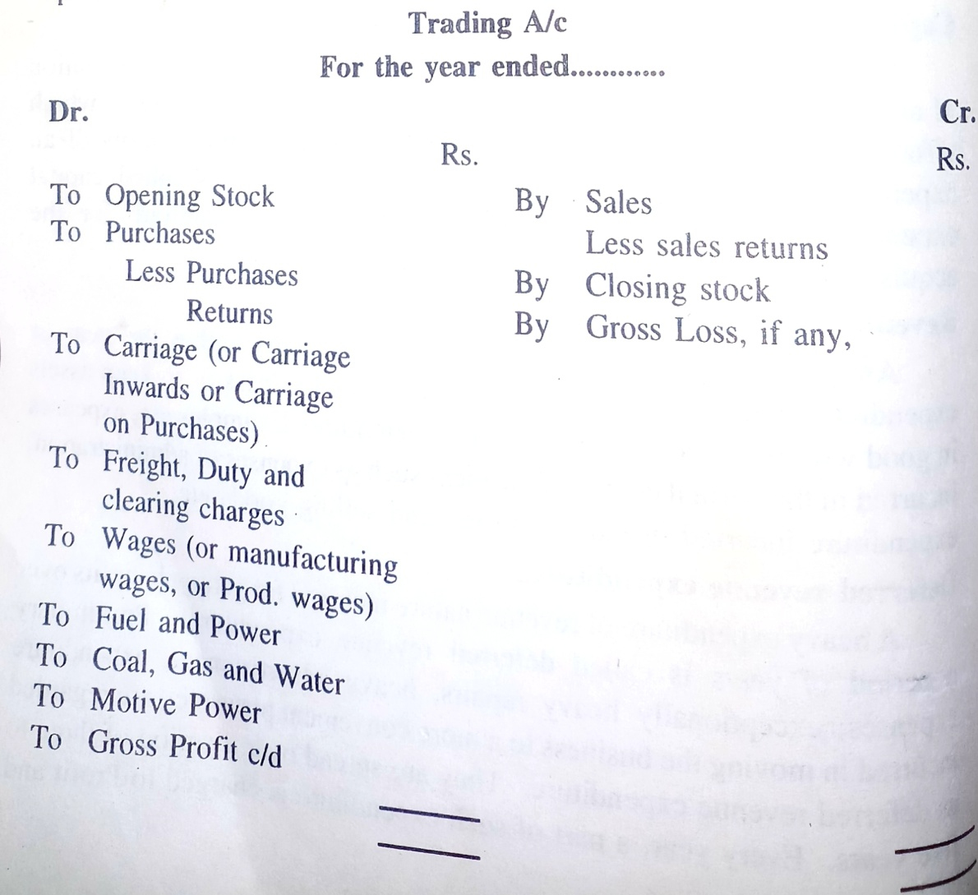

Slide 25
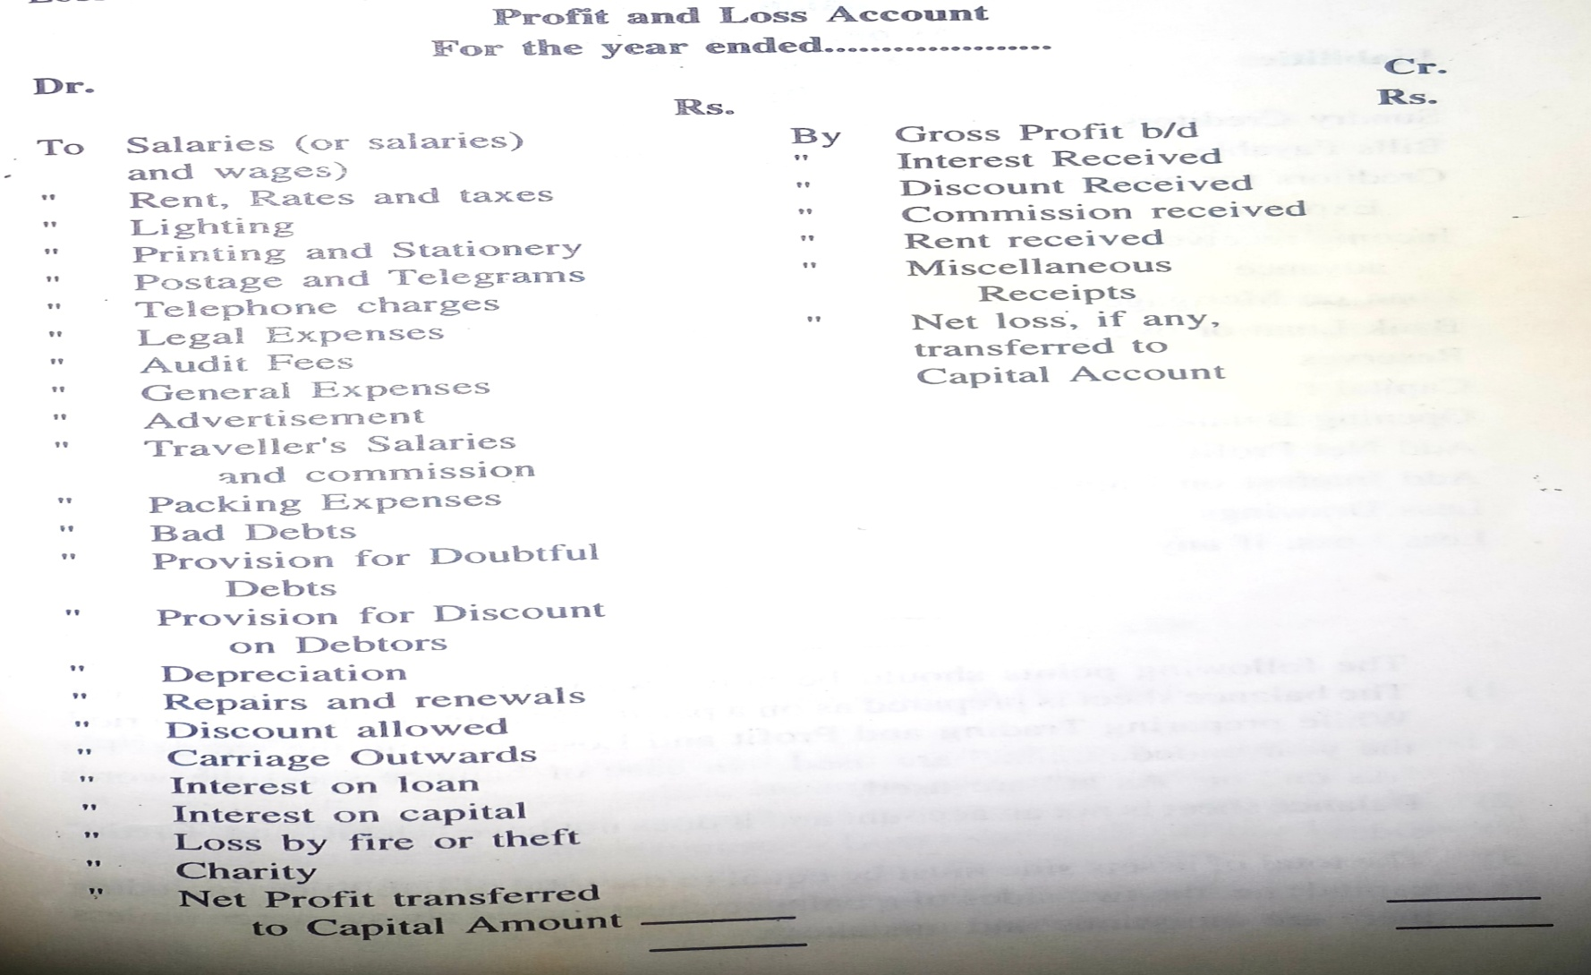

Slide 26
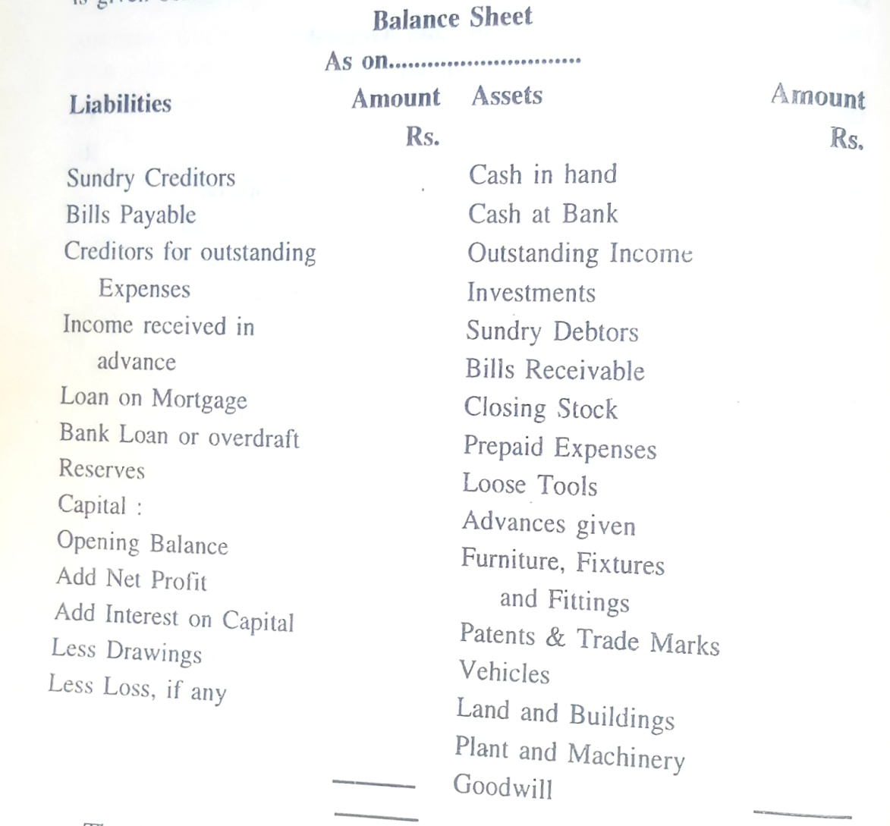

Slide 27
Prepare trail balance
Capital-100000
Machinery-30000
Stockon1.1.17-16000
Wages-50000
Carriage-500
Salaries-5000
Factory rent- 2400
Repairs-400
Fuel and power-2500
Buildings-40000
Sundry debtors-20000
Sales- 203600
Purchases-122000
Creditors-12500
Returns outwards-2000
Returns inwards-3600
Drawings-2000
Discount allowed-750
Discount received-250
Office exps-1000
Manufacturing exps-600
Bills payable-8500
Bills receivable- 5000
Cash in hand-2400
Cash at bank-15400
Office rent-1800

Slide 28
Particulars | Dr. Rs. | Cr. Rs
Capital |  | 100000
Machinery | 30000
Stock | 16000
wages | 50000
Carriage inwards | 500
salaries | 5000
Factory rent | 2400
repairs | 400
Fuel and power | 2500
buildings | 40000
Sundry debtors | 20000
sales |  | 203600
purchases | 122000
creditors |  | 12500
Returns out wards |  | 2000
Return inwards | 3600
Drawings | 2000

Slide 29
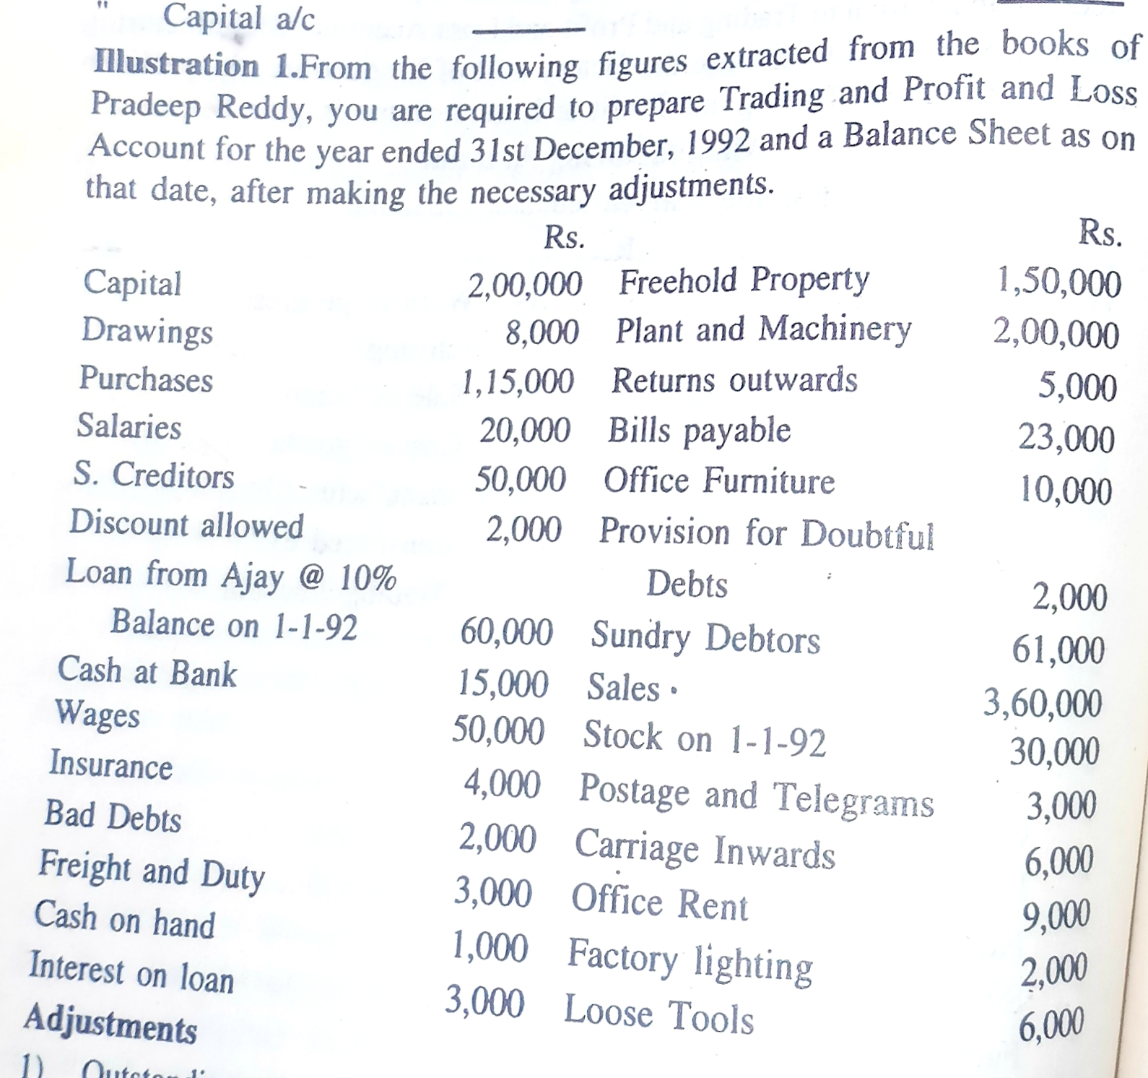

Slide 30
Adjustments:
1) Closing stock:
credit side of Trading account
asset side of balance sheet
2) Out standing expenses
liabilities side of b/s
add to concerned exps on debit side of P&L a/c
3) Prepaid or unexpired expenses:
- show it on asset side of b/s
- deduct from concerned exps

Slide 31
4) Outstanding or accrued income:
Show it on asset side of b/s
Added to concerned income on Cr. side of P&L
5) Income received in advance:
Deduct from concerned income in P&L credit side
Show it on the liabilities side of balance sheet
6) Depreciation- deduct from concerned asset
Show it on the debit side of P&L account

Slide 32
7) Interest on Capital:
show it on the debit side of P&L a/c
add to the capital on liabilities of balance sheet
8). Bad debts: deduct from sundry debtors on asset side of balance sheet
show it on the debit side of P&L a/c
9). RBD or Provision of doubtful debt
deduct from sundry debtors after deducting bad debts(N)
show it on the debit side of P&L a/c

Slide 33
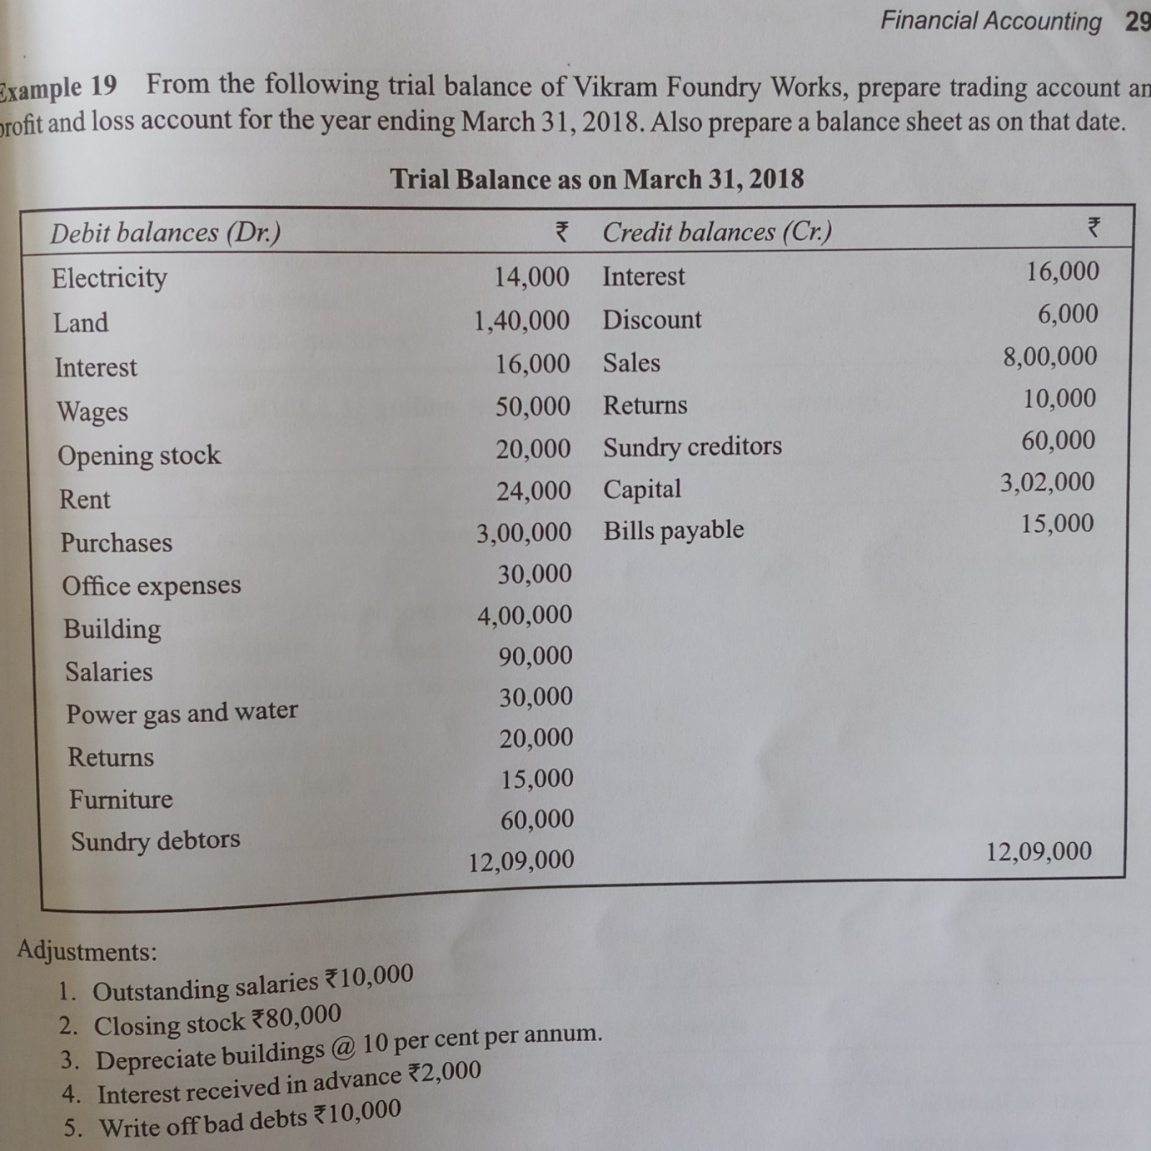

Slide 34
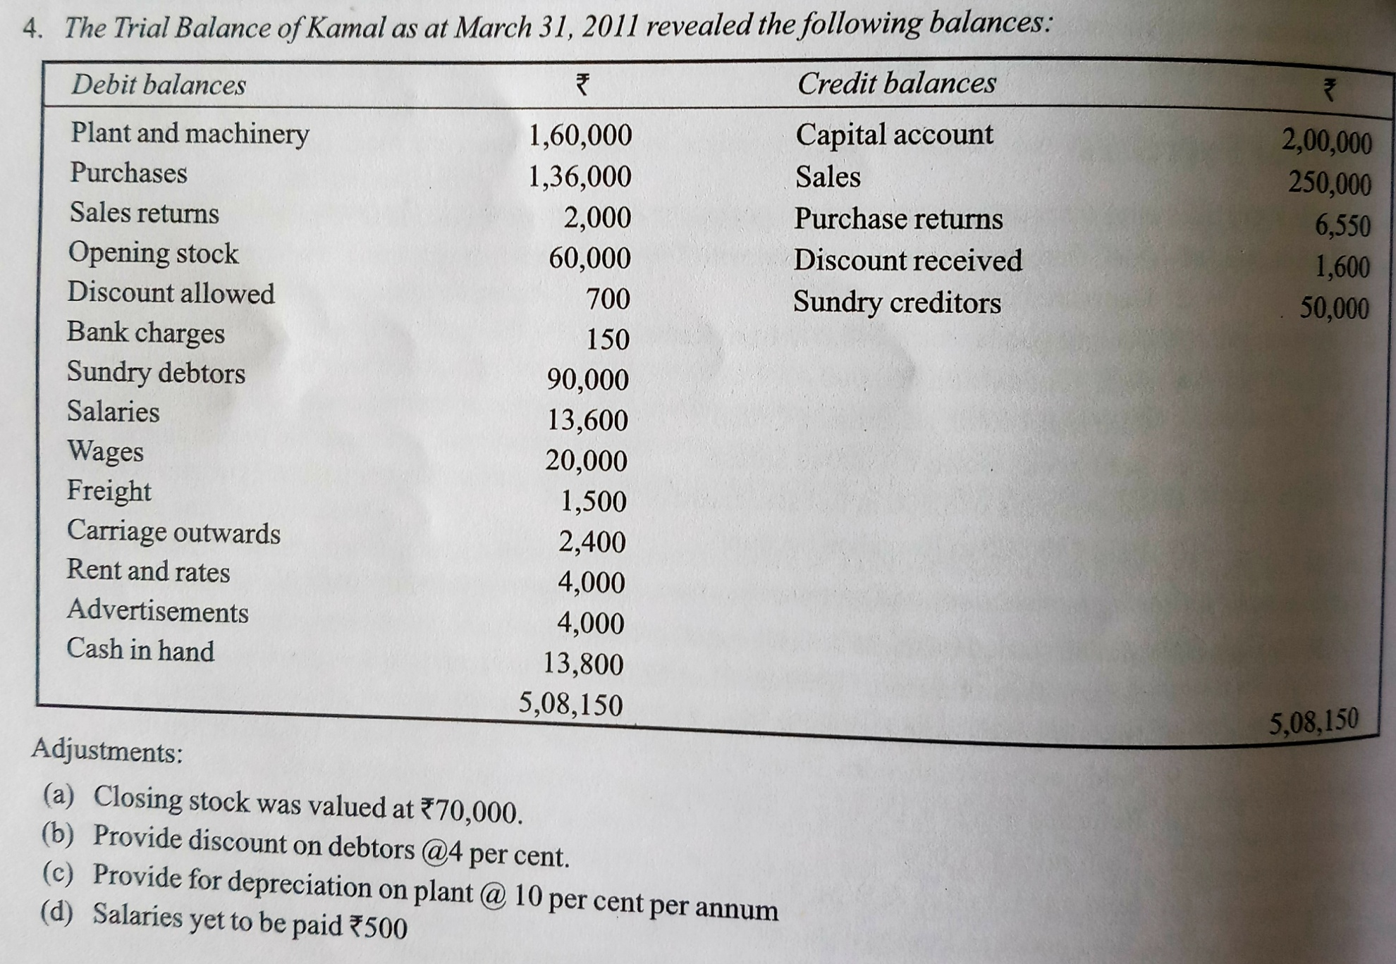

Slide 35
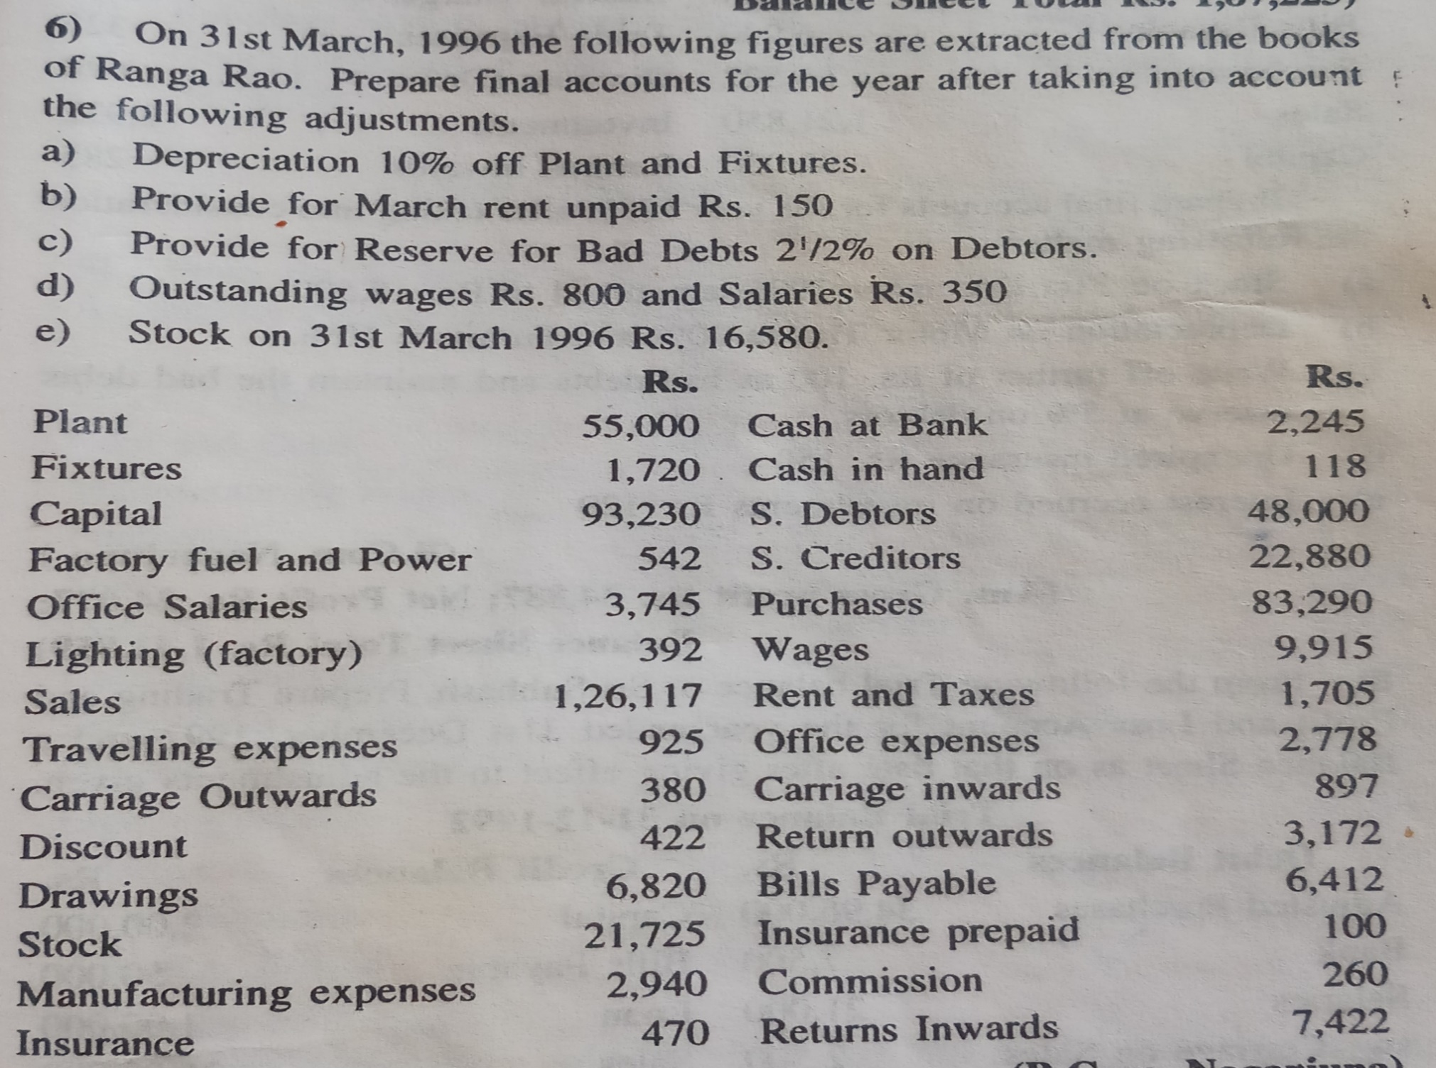

Slide 36
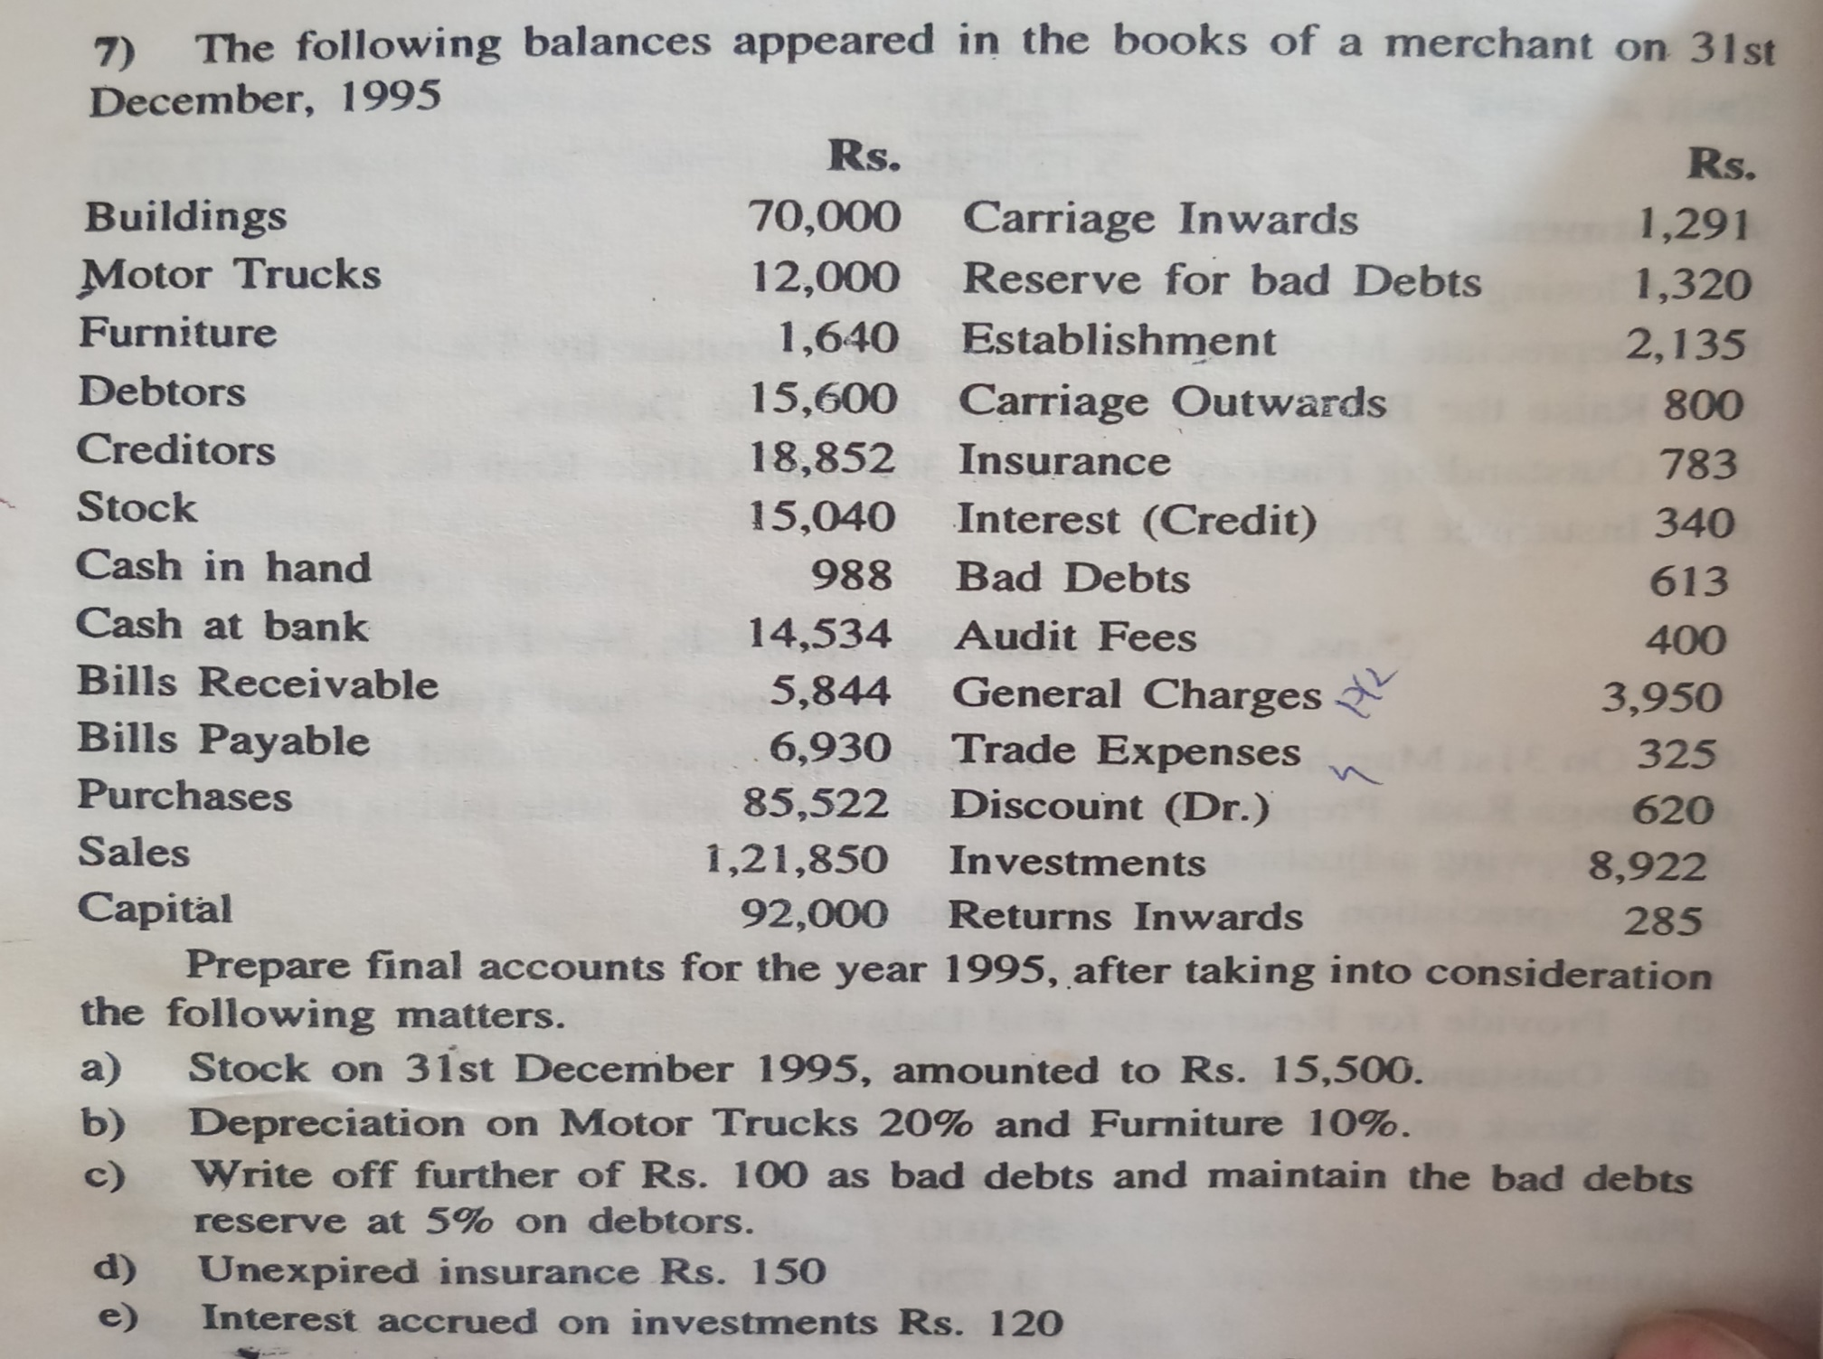

Slide 37


